Slide 1












CONTENT SUGGESTING SYSTEM
BASED ON THE USER’S PERSONALITY AND CURRENT MOOD
M.K. Damindu Pahasara (AA1680), A.S. Bandarathilaka (AA1706)
Supervised by Mr. Dinith Primal
School of Computing and IT
Sri Lanka Technology Campus, Ingiriya Road, Meepe, Sri Lanka
avishkabs@sltc.ac.lk | damindup@sltc.ac.lk

Slide 2



introduction
Search . . .
RESEARCH GAP
Content-suggesting systems have become very useful today.
There are many content-suggesting systems available on the internet. [1], [2], [3], [4], [5], [6], [7]
Existing systems only recommend content through emotion [1], [3], [4]
They recommend only one or two categories (Movies, Music) of digital content. [2], [4], [5], [6], [7]
They analyze existing user ratings and reviews and recommend content after categorizing them.[7]
Examples:
FaceFetch.[1], Emotion-based movie recommender system.[2], Low cost automated facial recognition system [3], Emotion-based music recommendation[4],etc.
Also, There is still a research gap in optimizing these systems to improve the suggestion algorithm and improve the user experience.

Slide 3
introduction
Academic PROBLEM
What?
Is there a more relevant and accurate way of automating the content suggestion based on the user's mood and personality?
Why?
No system to find media content on the internet that matches both users’ current mood and personality.
Existing systems will recommend content only either using emotion or based on user reviews of existing users.
System will be more accurate if it uses both current mood and personality.
How?
Identify the user’s personality and mood, analyze them, and recommend content based on that.
The user’s personality is determined using a questionnaire.
The current mood is identified by analyzing the facial features.
All operations will be operated on the cloud.

Slide 4


RESEARCH AIM AND OBJECTIVES
AIM
The aim is to provide a technical solution using both the current mood and the user’s personality, to suggest more relevant and accurate media content for the user on the internet

Slide 5
RESEARCH AIM AND OBJECTIVES
OBJECTIVES
Identify the personality of users.
Detect the current mood of the user.
Identify the related content for both personality and mood.
Save user personality.
Recommend digital content for users.

Slide 6
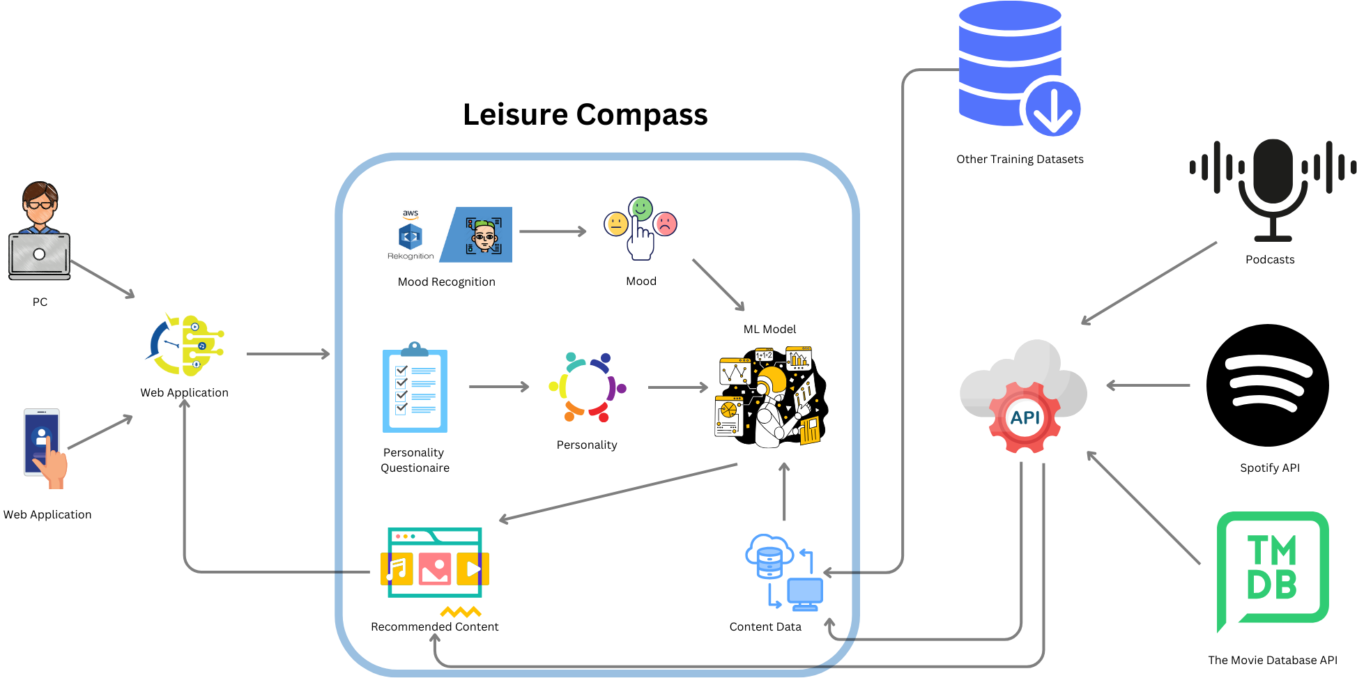
RESEARCH METHODOLOGY
System diagram

Slide 7
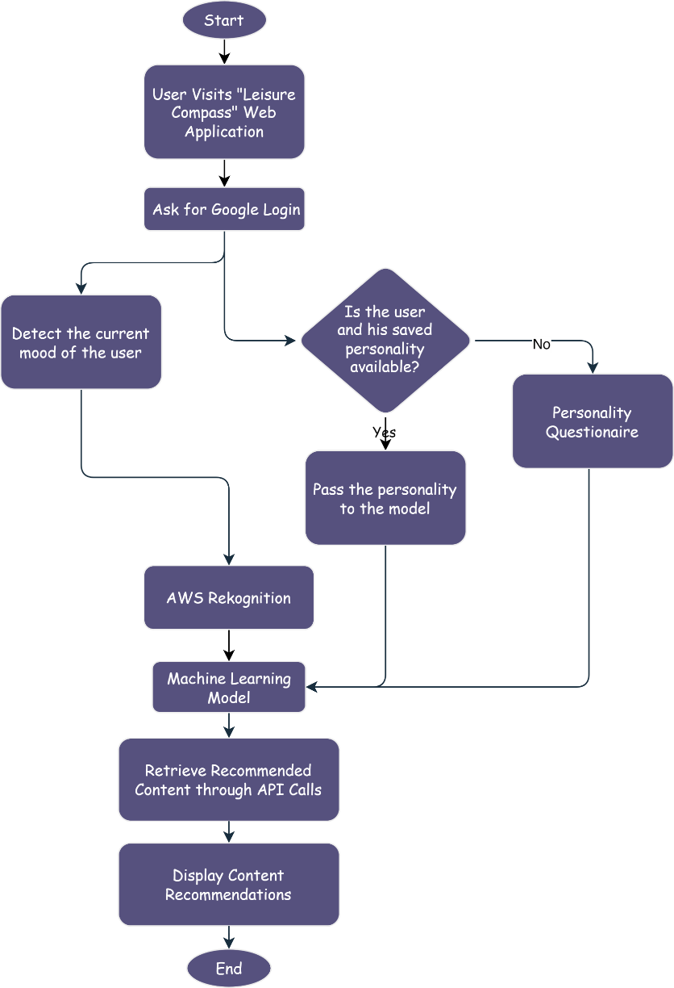
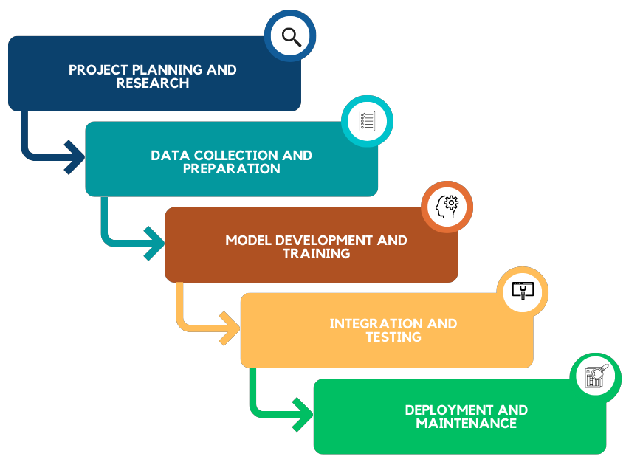
RESEARCH METHODOLOGY
System development METHODOLOGY
Pilot process

Slide 8
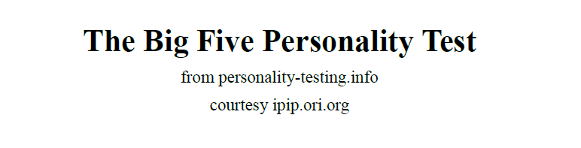
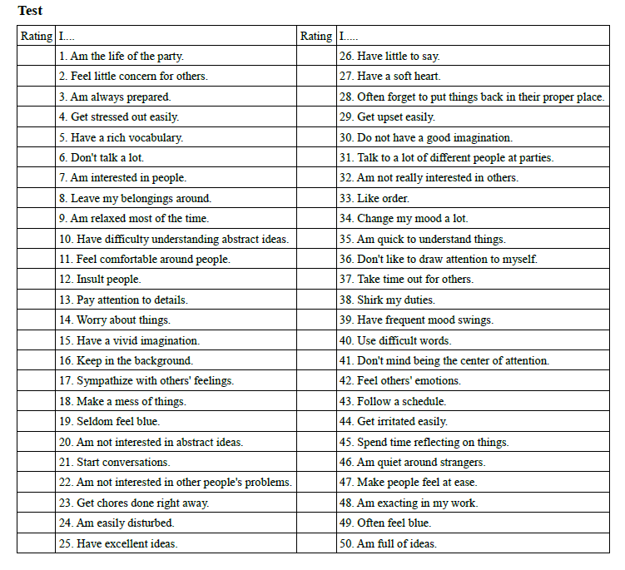
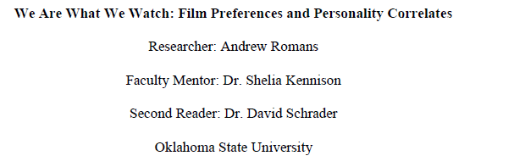
Used datasets & functions
Collaboration
Ms. Ishani Kariyawasam
Department Head
Psychology & Counselling
Openness
Conscientiousness
Extraversion
Agreeableness
Neuroticism
The Big Five Personality Dataset
The Big Five Personality Questionnaire
We are What We Watch Dataset

Slide 9


Used datasets & functions
Movie & TV Shows DATA
Content data
Movie id,
Topic,
category,
topic,
Language,
popularity
poster
Facial analysis DATA
AWS Rekognition module
Web browser camera

Slide 10
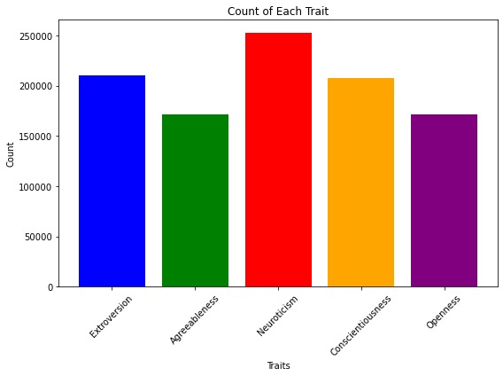
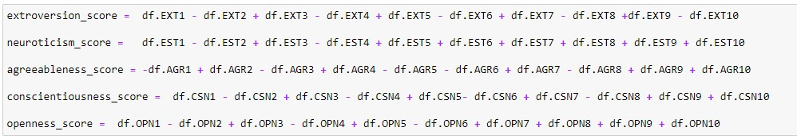
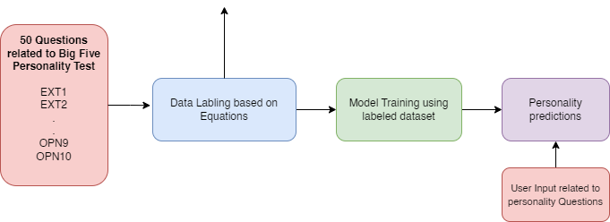
RESEARCH Results
Personality questionnaire algorithm
Big five personality test dataset
Personality Distribution in Training Dataset (Big Five Personality Test Dataset)
We transformed the dataset into a balanced dataset ensuring equitable representation across all classes.

Slide 11
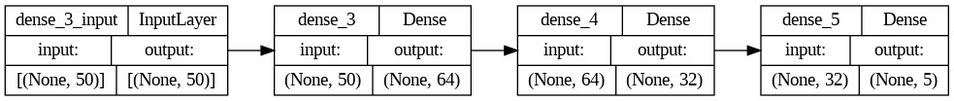
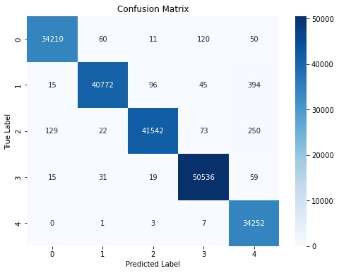
RESEARCH Results
Artificial neural network
Visualization of Artificial Neural Network
Dataset underwent training using an artificial neural network (ANN).
Achieved a testing accuracy score of 99.31%.
The user answers the personality questionnaire and feeds the data into the ANN model.
Artificial Neural Network confusion matrix

Slide 12
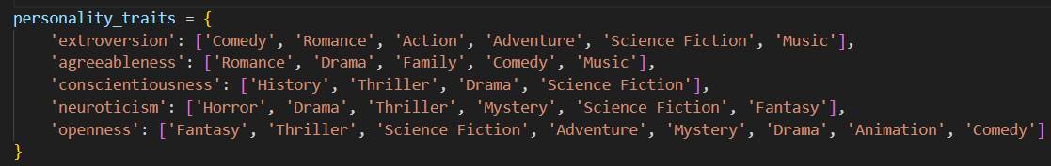
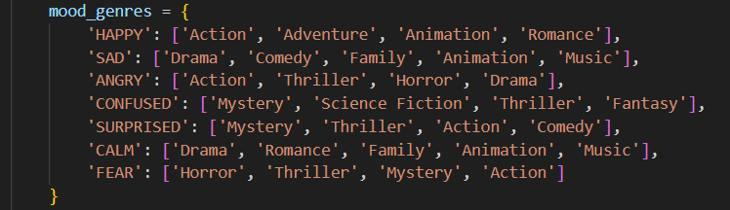
RESEARCH Results
Content recommendation
The ANN model generates personality outputs, which are then input into our algorithm based on We are what we watch dataset[1]
Analyzed various research papers and articles to understand how different genres resemble specific emotions [9], [10], [11], [12].
Also relied on general knowledge about human emotions and their responses to different types of media.
Our analysis showed that some people seek out content that mirrors their current mood to find relief
Combining these insights, we developed a set of genres tailored to different moods:

Slide 13
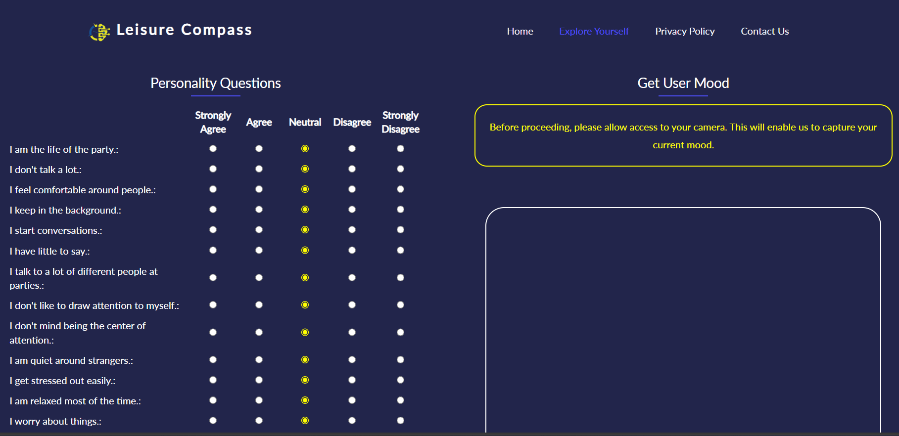
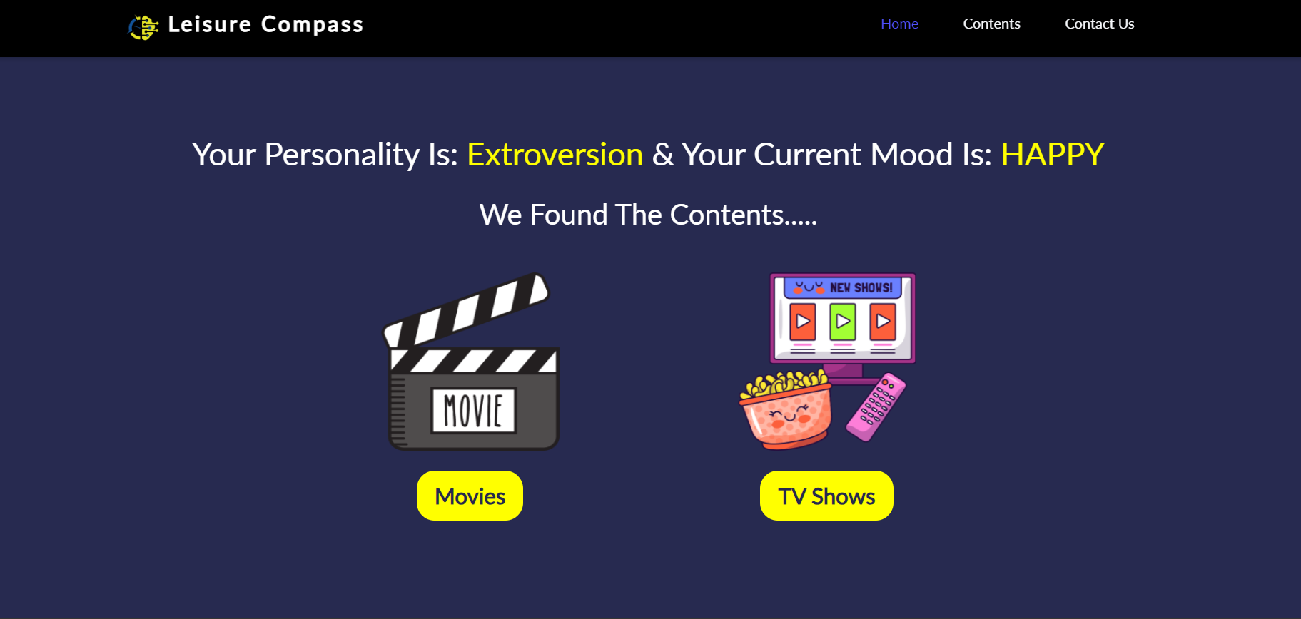
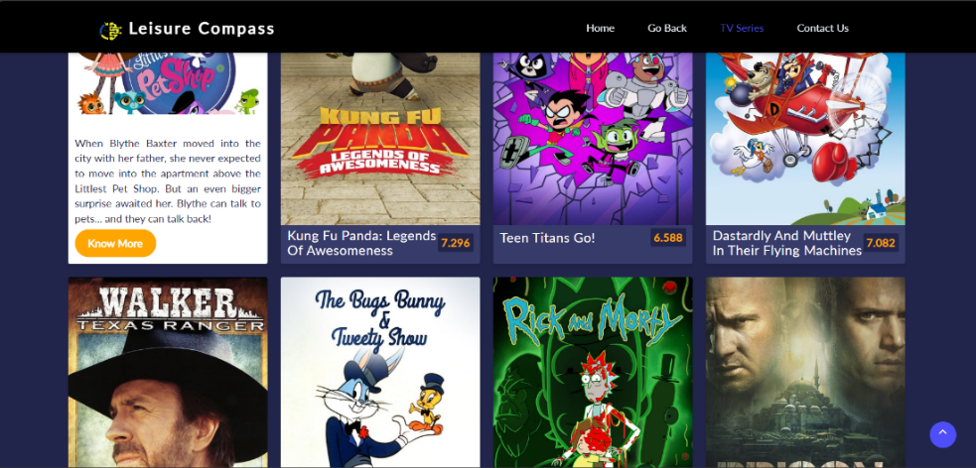



RESEARCH Results
Web application
Integrated the
Artificial neural network,
personality questionnaire
Mood recognition function, and other recommendation algorithms within the Flask web framework, alongside HTML and JavaScript components.
Web application was deployed on an EC2 instance hosted on AWS.
Personality questionnaire and mood detection
Recommended content – Movies & TV Shows
TV Shows

Slide 14
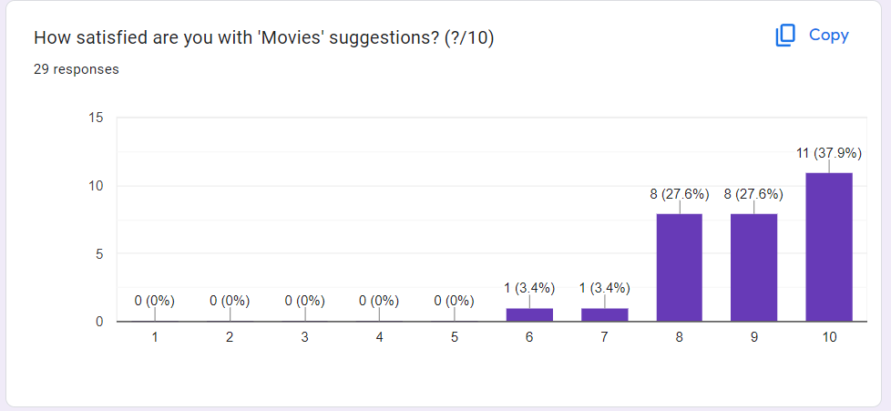
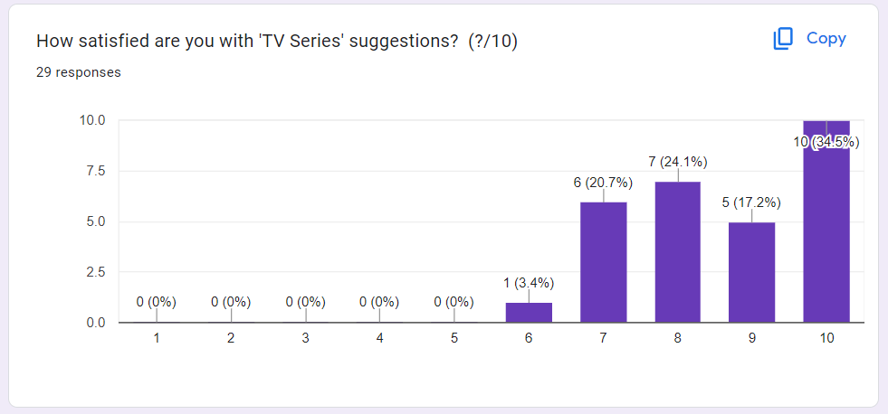
RESEARCH Results
User reviews
Conducted a user review session.
Received great ratings and positive reviews, showcasing its effectiveness.
Movies suggestions Responses
TV Shows suggestions Responses

Slide 15
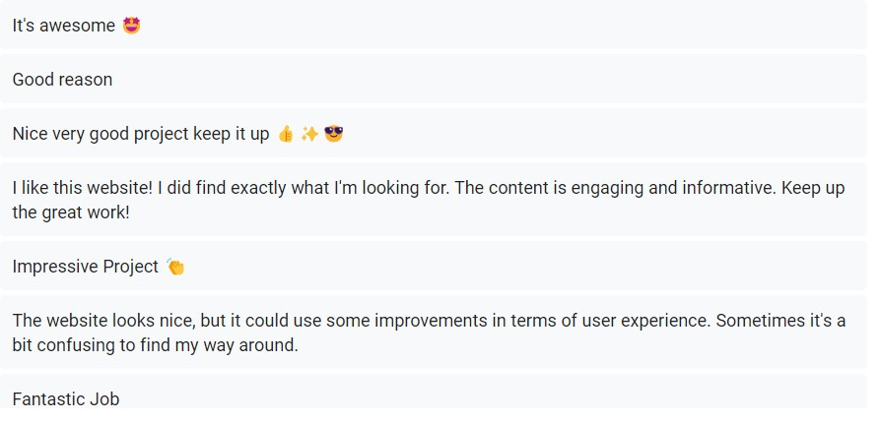
RESEARCH Results
User feedback
Conducted a user feedback session.
Received many suggestions & recommendations to improve our system.

Slide 16

Future work
Add Podcast recommendations
Add Music recommendations
Add Book recommendations
Improve the web application

Slide 17

CONCLUSION
A novel method for personalized content recommendation, leveraging user mood and personality profiling.
Through advanced analysis, our system delivers accurate content suggestions.
While initially focused on movies and TV shows, future iterations will expand to diverse media content.
Deployment on AWS ensures seamless access and scalability.
In summary, our innovative system enhances entertainment experiences with precision.

Slide 18
references
[1] A. Romans, We Are What We Watch: Film Preferences and Personality Correlates, 2015
[2] M. B. Mariappan, M. Suk, and B. Prabhakaran, “Face- fetch: A user emotion driven multimedia content recommendation system based on facial expression recognition,” in 2012 IEEE International Symposium on Multimedia, pp. 84–87, IEEE, 2012.
[3] M. Saraswat, S. Chakraverty, and A. Kala, “Analyzing emotion based movie recommender system using fuzzy emotion features,” International Journal of Information Technology, vol. 12, pp. 467–472, 2020.
[4] M. Y. Sai, R. V. C. Prasad, P. Niveditha, T. Sasipraba, S. Vigneshwari, and S. Gowri, “Low cost automated facial recognition system,” in 2017 Second International Conference on Electrical, Computer and Communication Technologies (ICECCT), pp. 1–5, IEEE, 2017.
[5] F.-F. Kuo, M.-F. Chiang, M.-K. Shan, and S.-Y. Lee, “Emotion-based music recommendation by association discovery from film music,” in Proceedings of the 13th annual ACM international conference on Multimedia, pp. 507–510, 2005.
[6] S. Rho, B.-j. Han, and E. Hwang, “Svr-based music mood classification and context-based music recommendation,” in Proceedings of the 17th ACM international conference on Multimedia, pp. 713–716, 2009.
[7] W. Zhao, X. Wang, and Y. Wang, “Automated sleep quality measurement using eeg signal: first step towards a domain specific music recommendation system,” in Proceedings of the 18th ACM international conference on Multimedia, pp. 1079–1082, 2010.
[8] S. Zhao, H. Yao, X. Sun, P. Xu, X. Liu, and R. Ji, “Video indexing and recommendation based on affective analysis of viewers,” in Proceedings of the 19th ACM international conference on Multimedia, pp. 1473–1476, 2011.
[9]P. a. T. T. Y. Winoto, "The role of user mood in movie recommendations," Expert Systems with Applications, vol. 37, pp. 6086-6092, 2010.
[10]S. S. a. N. N. a. S. P. a. B. P. Acharya, "Mood-based movie recommendation system," in Biologically Inspired Techniques in Many Criteria Decision Making: Proceedings of BITMDM 2021, 2022, pp. 151-158.
[11]A. Miller, "Understand How These Genres Affect Our Movie Emotions," December 2022. [Online]. Available: https://nofilmschool.com/genres-affect-our-movie-emotions.
[12] M. Mehraei, "Investigating the Influence of Movie Genre on Mood Using Nonparametric Methods".

Slide 19


Slide 20
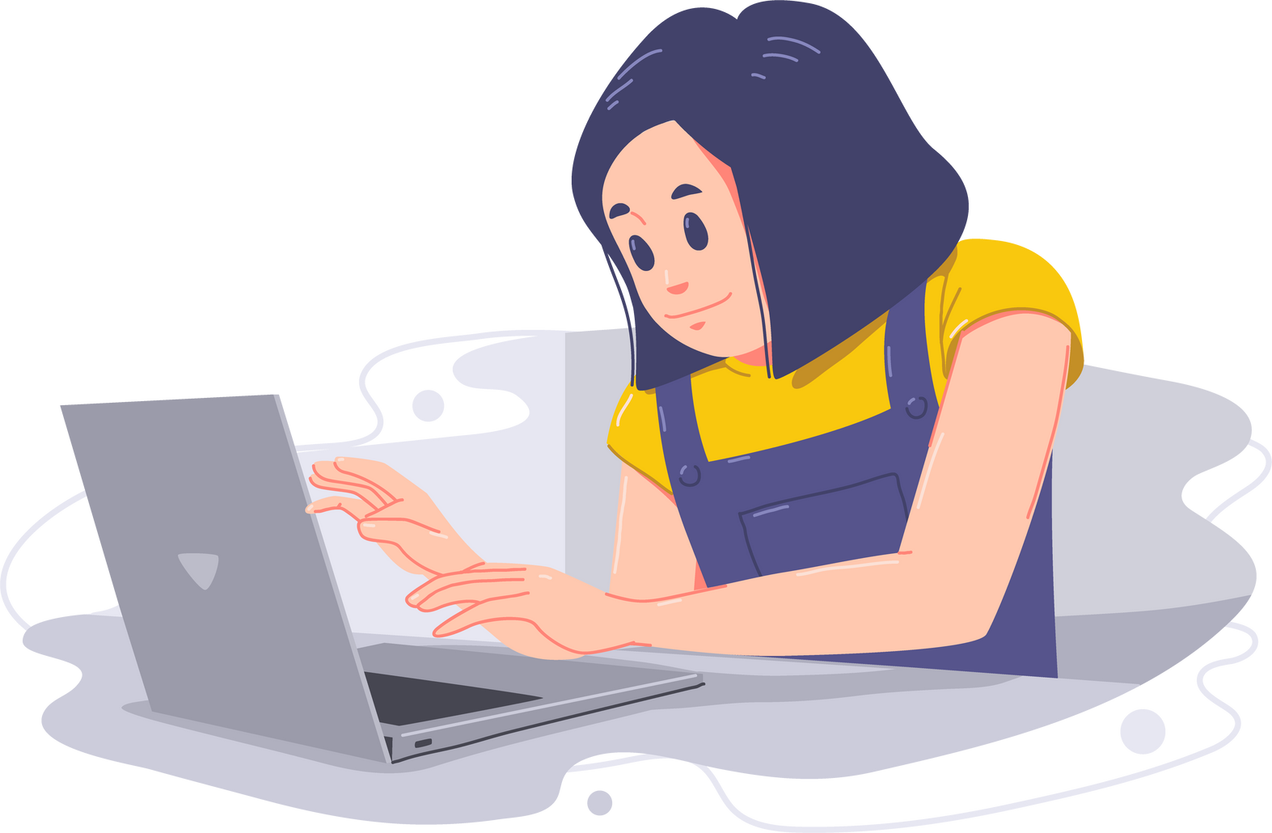
Search . . .
THANK YOU

